Slide 1
Smart Traffic Light Control System with YOLOv3
IOMP ID:IT-25-05
23265A1206 - P.Soumya
23265A1205 - M.Krishna Sahee
GUIDE:
Mrs. A. V. L. PRASUNA

Slide 2

MAHATMA GANDHI INSTITUTE OF TECHNOLOGY(A)
DEPARTMENT OF INFORMATION TECHNOLOGY
An Industry Oriented Mini Project(IT653PC)
On
Smart Traffic Light Control System
By
M. Krishna Sahee(23265A1205)
P. Soumya(23265A1206) Batch ID: IT-24-05
IOMP Supervisor
Mrs.U.Chaitanya
Assistant Professor
Internal Supervisor
Mrs. A. V. L. PRASUNA
Assistant Professor

Slide 3
CONTENTS
Abstract
Introduction
Existing System
Proposed System
Applications
Software and Hardware Requirements
Literature Survey
Problem Statement
Objectives
Module Description
Algorithms
Design Architecture and UML Diagrams
Result
Test Cases
Conclusion and Future Enhancement
References

Slide 4
ABSTRACT
Traffic congestion at intersections is worsened by traditional fixed-timer traffic lights that ignore real-time conditions. This project introduces a Smart Traffic Light System using YOLOv3 and OpenCV to detect and count vehicles and pedestrians from video feeds. Based on these counts, the system dynamically adjusts red light durations to improve traffic flow extending green lights during heavy traffic and shortening them when traffic is light. The counts and timings are displayed on the video feed for easy monitoring. This system improves traffic efficiency and can be expanded for use with live CCTV and physical traffic controllers in smart cities.

Slide 5
INTRODUCTION
As urban populations grow, traffic congestion has become a major challenge in modern cities, particularly at intersections controlled by static traffic light systems. These conventional systems operate on fixed time intervals, which often results in inefficient traffic flow and unnecessary delays. To address this issue,this project presents a Smart Traffic Light System that leverages computer vision to optimize traffic signal timings. By using YOLOv3 (You Only Look Once), a fast and accurate object detection algorithm, along with OpenCV for image processing, the system detects and counts vehicles and pedestrians from live or recorded video feeds. Based on this data, it dynamically adjusts red light durations to match current traffic conditions.

Slide 6
EXISTING SYSTEM
The existing traffic light systems in most cities operate based on fixed-time intervals or simple timer-based controls. These systems typically follow a pre-set schedule for each traffic light, regardless of the actual traffic conditions at any given time. This leads to inefficiencies such as:
Unnecessary delays: Even if there are no vehicles or pedestrians waiting, the traffic light still stays red.
Traffic congestion: In areas with heavy traffic, vehicles often wait longer than necessary due to the fixed timer.
Environmental impact: Extended idling times increase fuel consumption and emissions.

Slide 7
PROPOSED SYSTEM
Real-Time Detection: Utilizes YOLOv3 and OpenCV to detect and count vehicles and pedestrians from live or recorded video feeds.
Dynamic Signal Adjustment: Calculates red light durations based on real-time traffic density, minimizing idle times for vehicles and pedestrians..
User-Friendly Interface: Displays real-time object counts and computed timers directly on the video feed using OpenCV.
Scalability and Integration: Easily integrates with existing infrastructure, such as CCTV cameras and Arduino-based traffic controllers.

Slide 8
APPLICATIONS
Real-Time Traffic Flow Optimization: Dynamically adjusts signal timings based on live traffic data to reduce congestion and improve vehicle flow.
Emergency Vehicle Prioritization: Detects emergency vehicles and alters traffic signals to provide them with a clear path, facilitating quicker response times.
Pedestrian Safety Enhancement: Monitors pedestrian presence and adjusts signal timings to ensure safer crossings.
Environmental Impact Reduction: Optimizes traffic flow to minimize idling, thereby reducing fuel consumption and lowering emissions.
Data Collection for Urban Planning: Gathers real-time traffic data for analysis, aiding in informed decision-making for future infrastructure development.

Slide 9
HARDWARE AND SOFTWARE SPECIFICATIONS
Hardware Components:
Network/Wi-Fi: For video feed transmission.
RAM: 16GB (32GB preferred) for video processing.
Software Components:
OS: Windows 10 or higher.
Programming: Python, HTML/CSS.
Libraries: OpenCV (for image processing), YOLOv3 (for object detection).

Slide 10
LITERATURE SURVEY
References | Author(s) & Year | Journal / Conference & Publisher | Methodology / Techniques Used | Merits | Demerits | Research Gaps
1 | Wet Zhcu et al., 2023 | IEEE Trans. on Intelligent Transportation Systems | Pedestrian crossing intention prediction using surveillance video | Over-the-horizon safety alerts; effective intention prediction | Relies on surveillance infrastructure; privacy concerns | Real-time deployment issues: vehicle system integration
2 | Mahbubul Alam Palash & Duminda Wijesekera, 2023 | IEEE – VTC 2023 – Fall – IEEE | Adaptive traffic signal control using CNNs on signal recognition | Real-time signal optimization; reduced traffic delay | Requires C-V2X infrastructure; privacy concerns | Real-time deployment issues: vehicle system integration
3 | Iswarlya Logeswaran et al., 2023 | IEEE – Autonomous Vehicles & Sign Recognition | CNN-based pedestrian detection and traffic sign recognition for AVs | Integration of detection and signs; suitable for real-time use | No adaptive learning or AI decision-making | No real-time performance reliability in urban setups
4 | Chenyao Bai, Yi Gong, Xiaojie Cao (2020) | IEEE | Pedestrian tracking and trajectory analysis for security monitoring | Accurate tracking in crowded scenes | May not generalize to varying camera angles | Real-time scalability and diverse environment validation
5 | Mohammed Saleh Ali Muthanna, Yuliy T. Lyachek, Abdulfattah Mohammed Obadi Musaeed (2020) | IEEE | Real-time pedestrian detection system | Enhanced safety for smart cities | High computational cost | Need for lightweight and low-cost implementations

Slide 11
PROBLEM STATEMENT
Today’s pedestrian lights don’t change with what’s really happening—they make people wait too long when no one’s around and don’t give enough time when lots of people need to cross. Cars also get stuck in stop-and-go traffic, and some walkers take risks by dodging signals. Our solution uses a camera and YOLOv3 to watch how many people and cars are waiting, figures out the best walk time on the spot, and updates the light right away—so nobody waits too long, traffic moves smoother, and everyone stays safer.

Slide 12
OBJECTIVES
Enhance Traffic Management: Improve the flow of traffic at intersections through dynamic signal adjustments based on real-time data.
Reduce Waiting Times: Minimize unnecessary delays for vehicles and pedestrians by optimizing red light durations.
Increase Efficiency: Implement a cost-effective, automated system that reduces fuel consumption and emissions.

Slide 13
MODULE DESCRIPTION
1. Object Detection Module
Purpose: Detects and classifies objects (vehicles and pedestrians) in real-time
Technology: Uses YOLOv3 and OpenCV.
Functionality:
Loads a pre-trained YOLOv3 model.
Processes video frames from a webcam or video file.
Identifies objects and counts the number of vehicles and pedestrians.
Output: Returns object counts (used to determine traffic light duration).

Slide 14
2. Traffic Duration Calculation Module
Purpose: Determines how long the red light should remain on based on traffic density.
Functionality:
Uses a simple rule-based formula: more objects = longer red light.
Calculates the red light duration dynamically for each frame or time window.
Output: Duration value in seconds for the simulated red light.
3. Video Processing and Display Module
Purpose: Processes and displays real-time video with detection overlays.
Functionality:
Displays the live video with bounding boxes around detected objects.
Shows counts of vehicles and pedestrians on-screen.
Uses OpenCV GUI window (cv2.imshow) for visual feedback.
User Interaction: Controlled through keyboard input (e.g., to quit or reset).

Slide 15
4. Signal Simulation and Timer Module
Purpose: Simulates red light timing based on traffic analysis.
Functionality:
Displays a red light countdown timer on the video screen.
Visually represents traffic light logic for demonstration purposes.
Can be extended to include green/yellow light simulation.

Slide 16
ALGORITHM
The Smart Traffic Light System begins by loading the pre-trained YOLOv3 object detection model along with the class labels. It captures video frames using OpenCV and processes each frame to detect pedestrians and vehicles using YOLOv3. The system then counts the number of detected objects and calculates the appropriate red light duration using a weighted formula based on these counts. The results, including object counts, red signal time, and a visual traffic light indicator (red or green), are overlaid directly on the video feed. This process continues in real time until the video ends or the user stops the system.

Slide 17
1. Input Layer: Real-time Video & Model Setup
Inputs:
Video Feed: sampleinput3.mp4 (or a live camera feed)
YOLOv3 Files:
yolov3.weights – Pretrained model
yolov3.cfg – Model architecture
coco.names – Object classes (person, car, etc.)
Preprocessing:
Frame Extraction: Read every frame (or every 2nd frame for efficiency).
Resizing and Normalization: Use OpenCV blob conversion to feed YOLOv3.
Model Input Preparation: Frame is turned into a blob and input into YOLO.

Slide 18
2. Hidden Layer: Detection, Classification & Analysis
Object Detection & Classification:
Run YOLOv3 to detect:
Pedestrians: Label = person
Vehicles: Labels = car, truck, bus, motorbike
Apply Non-Maximum Suppression (NMS) to avoid duplicate bounding boxes.
Pattern Recognition:
Avoid double-counting pedestrians using position proximity.
Count total:
pedestrian_count
vehicle_count

Slide 19
Intelligent Decision Logic:
Use a custom weighted formula to calculate red light duration:
makefile
CopyEdit
red_time = base_duration + (pedestrian_count × adjustment × weight) + (vehicle_count × adjustment × weight)
Ensure:
Minimum red time ≥ 5 sec
Maximum red time ≤ 60 sec
3. Feedback Layer: Visual Feedback on Screen
Real-time Feedback Loop:
Draw bounding boxes around detections.
Display overlay texts:
Pedestrian count
Vehicle count
Red signal duration

Slide 20
Visual Signal Indicator:
Display a red or green circle:
Red if red light is active.
Green if not needed.
4. Output Layer: Decision Execution & Visualization
Display:
OpenCV window shows:
Annotated video frame
Live counts and timer
Signal status (Red/Green)
No Web/Database:
This version does not store logs or history.
Purely real-time, visual feedback only.

Slide 21
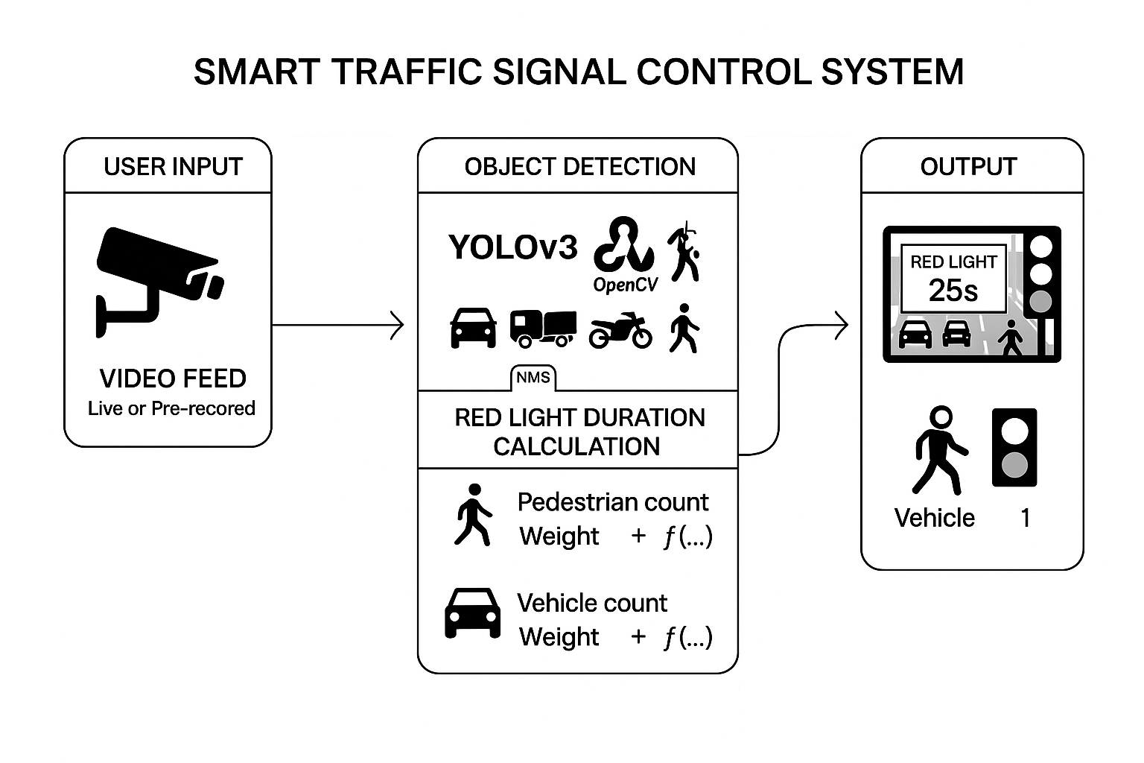
DESIGN ARCHITECTURE

Slide 22
UML DIAGRAMS

Slide 23
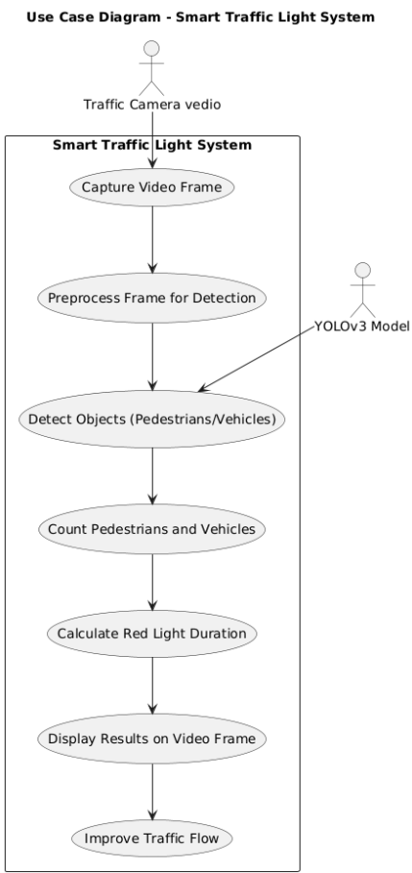
USE CASE DIAGRAM

Slide 24
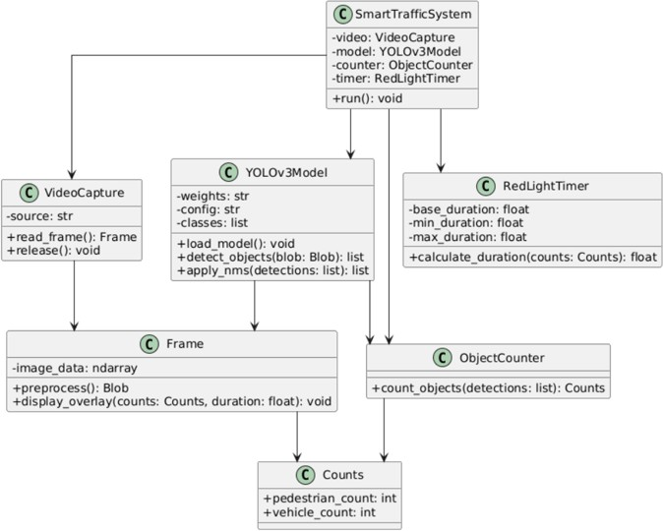
CLASS DIAGRAM

Slide 25
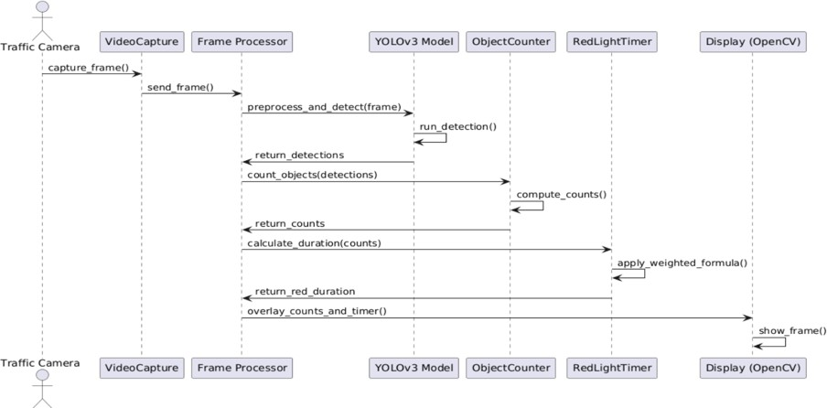
SEQUENCE DIAGRAM

Slide 26
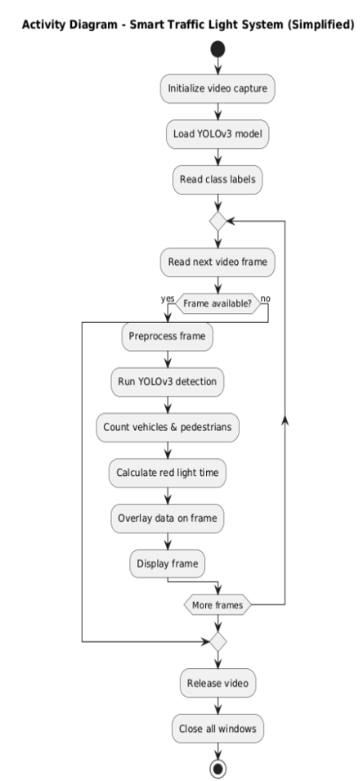
ACTIVITY DIAGRAM

Slide 27
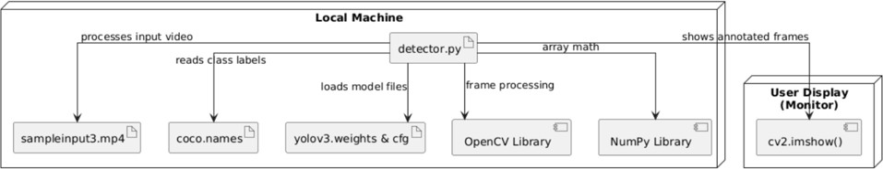
DEPLOYMENT DIAGRAM

Slide 28
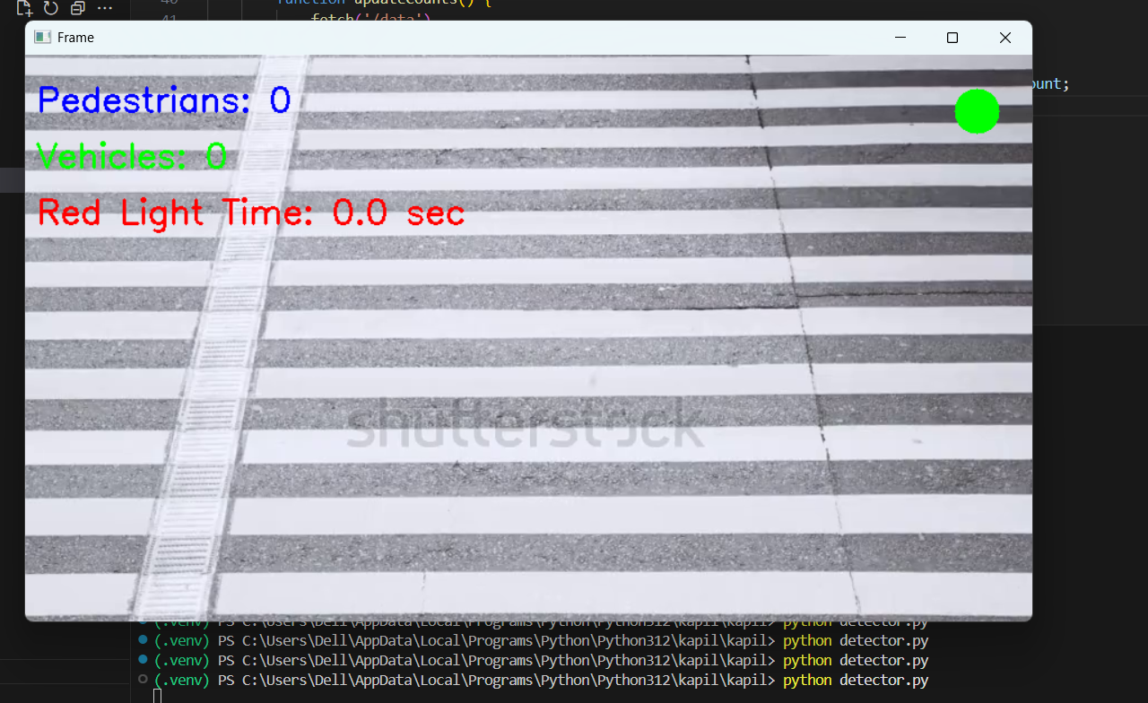
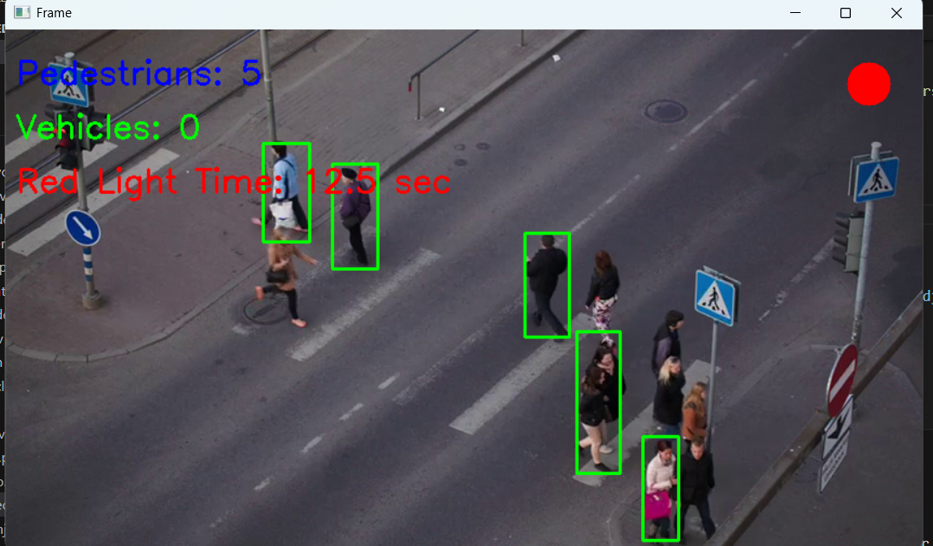
RESULT
Fig 1: Initial count and signal
Fig 2: pedistrain count and signal

Slide 29
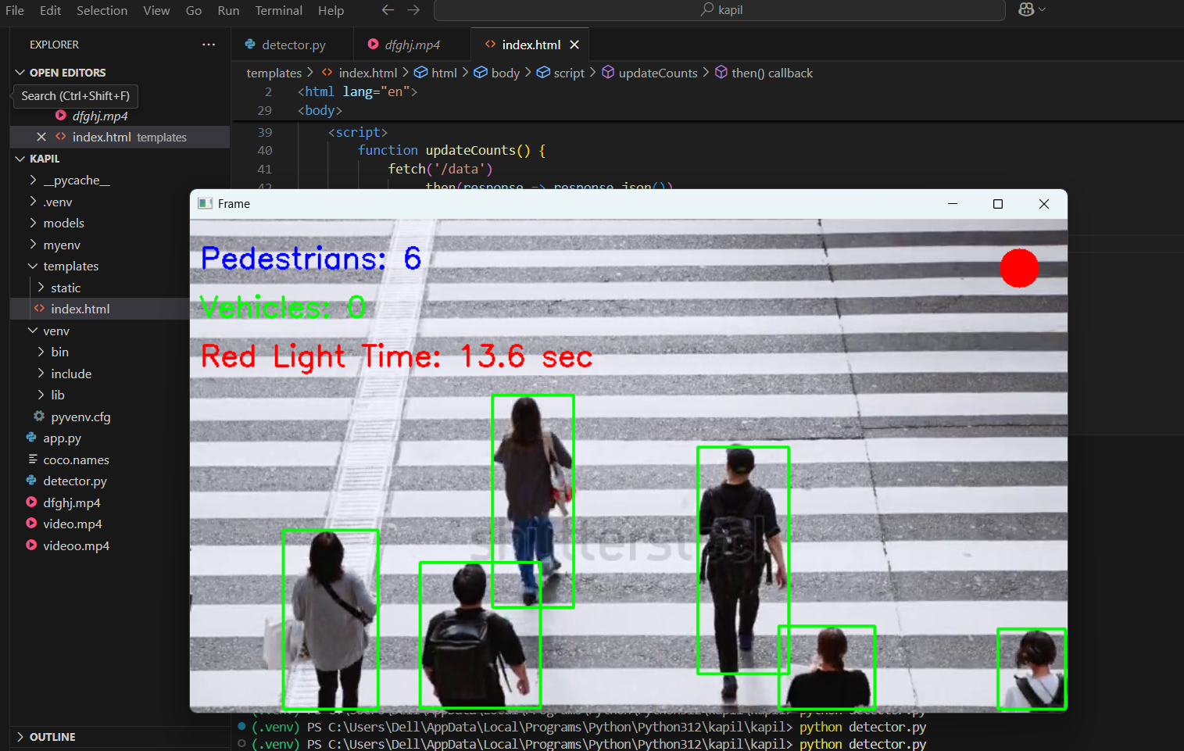
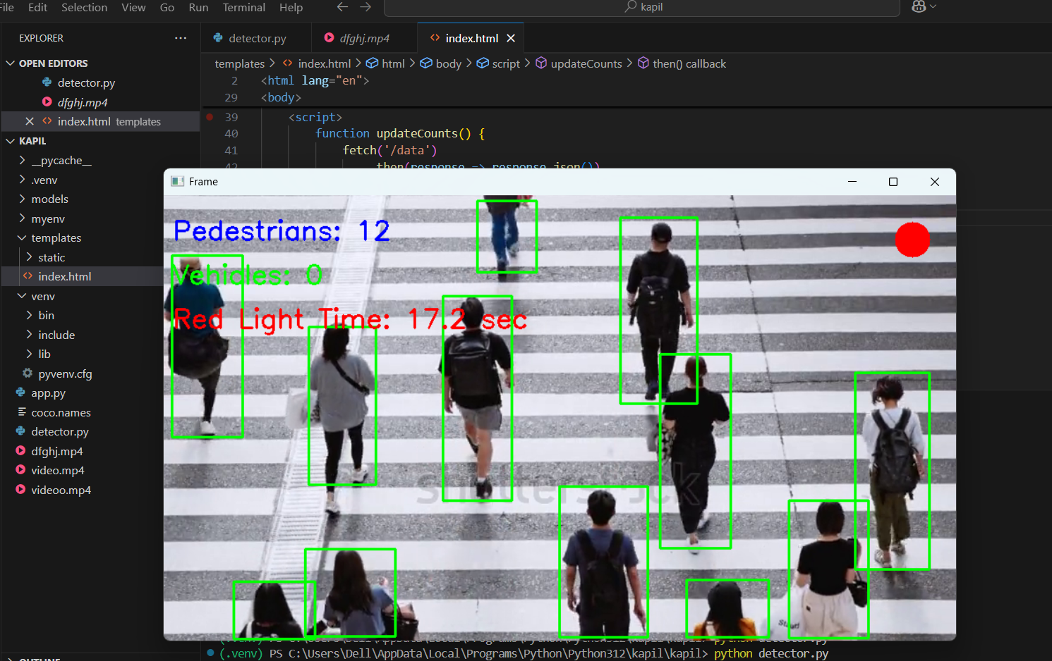
Fig 3: pedistrain count and signal
Fig 4: pedistrain count and signal

Slide 30
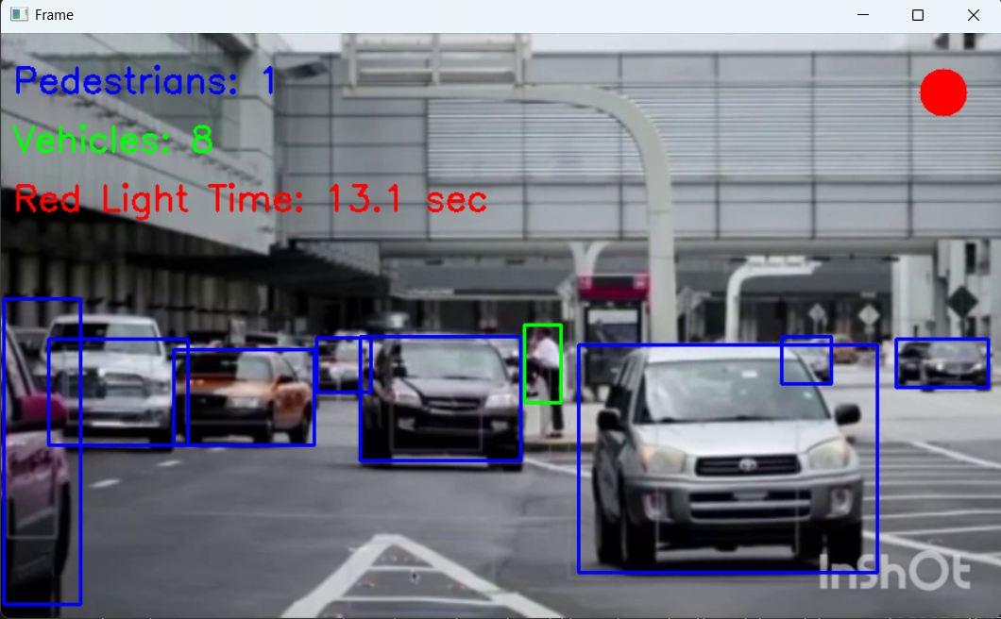
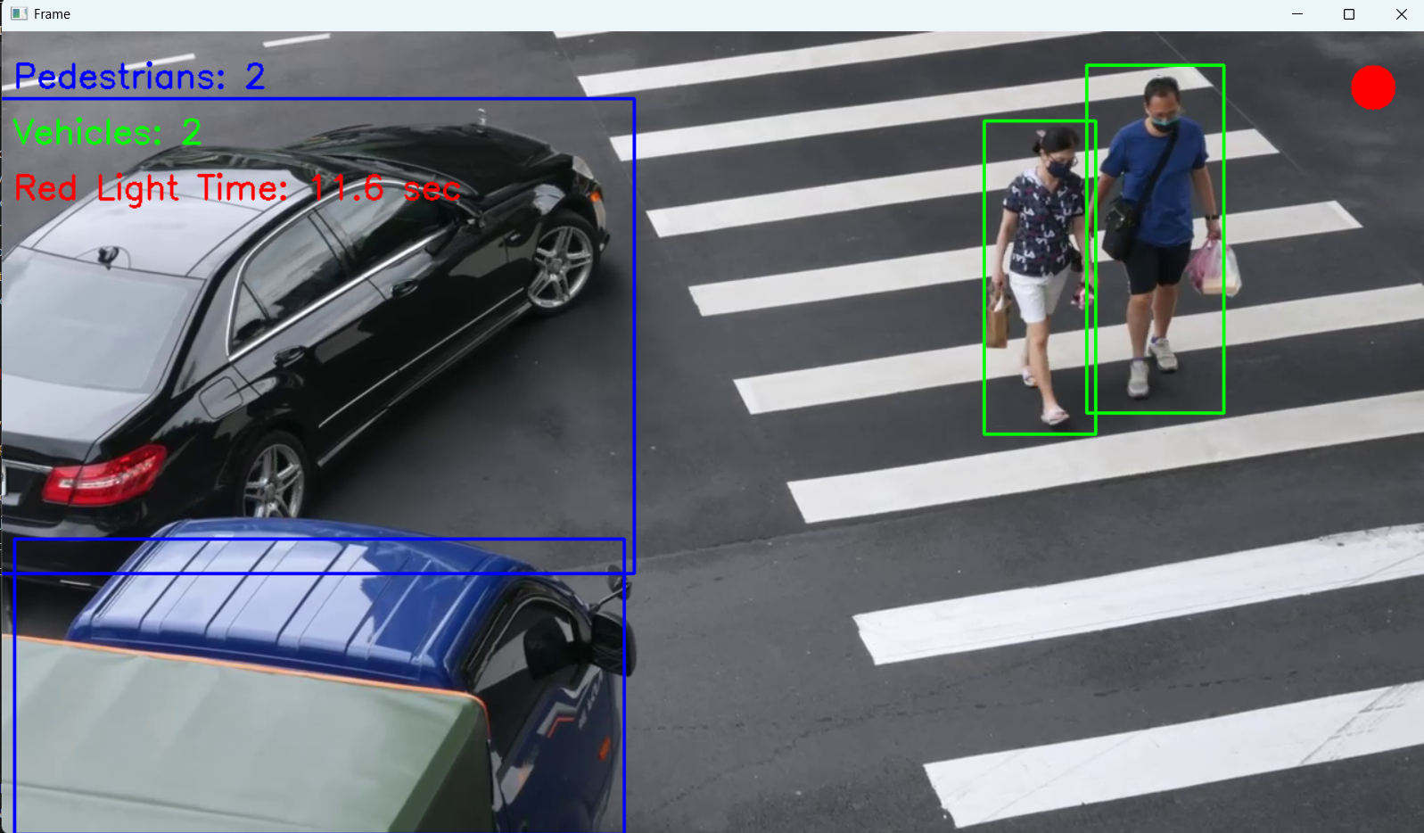
Fig 5: vechicle count and signal
Fig 6: vechicle count and signal

Slide 31
TEST CASES
S . NO | Test Scenario | Expected Result | Actual Result | (Pass/Fail) | Remarks
1. | Pedestrian count | Should display count of pedestrians | Displays accurate count in each frame | PASS | Successfully executed
2. | Vehicle count | Should display count of Vehicles | Displays accurate count in each frame | PASS | Successfully executed
3. | Time for Red signal | Must calculate and display signal duration based on counts | Displays the approximate red signal duration | PASS | Executed and displayed as expected
4. | Frames display | Should identify vehicles and pedestrians using frames | Pedestrians and vehicles are identified using green and blue frames | PASS | The frames are displayed accurately

Slide 32
CONCLUSION
The smart traffic light control system uses YOLOv3-based object detection to create a smart, real-time traffic light control system. It detects vehicles and pedestrians from video, calculates optimal red light durations dynamically, and displays results via a live video feed and web dashboard. By automating signal timing based on actual traffic conditions, it reduces congestion.

Slide 33
FUTURE ENHANCEMENT
Live CCTV Integration: Use real-time footage from street cameras instead of webcam or videos.
Arduino Traffic Light Control: Control actual traffic lights using Arduino or Raspberry Pi.
Emergency Vehicle Detection: Detect ambulances, fire trucks, etc., and give them green light priority.
Traffic Data Storage: Save traffic counts for future analysis and reporting.

Slide 34
REFERENCES
[1] Wet, Zhcu et al., (2023). "Pedestrian crossing intention prediction using surveillance video." IEEE Transactions on Intelligent Transportation Systems.
[2] Mahbubul Alam Palash & Duminda Wijesekera (2023). "Adaptive traffic signal control using CNNs on signal recognition." IEEE VTC 2023 – Fall – IEEE.
[3] Iswarlya Logeswaran et al., (2023). "CNN-based pedestrian detection and traffic sign recognition for AVs." IEEE – Autonomous Vehicles & Sign Recognition.
[4] Chenyao Bai, Yi Gong, Xiaojie Cao (2020). "Pedestrian tracking and trajectory analysis for security monitoring." IEEE
[5] Mohammed Saleh Ali Muthanna, Yuliy T. Lyachek, Abdulfattah Mohammed, Obadi Musaeed (2020).
"Real-time pedestrian detection system." IEEE.

Slide 35
EXECUTION LINK
https://drive.google.com/file/d/18S9wEC4Ut62bCbBy0Z753l3t99GbeB7s/view?usp=drive_link

Slide 36
https://drive.google.com/file/d/18S9wEC4Ut62bCbBy0Z753l3t99GbeB7s/view?usp=drive_link

